Slide 1
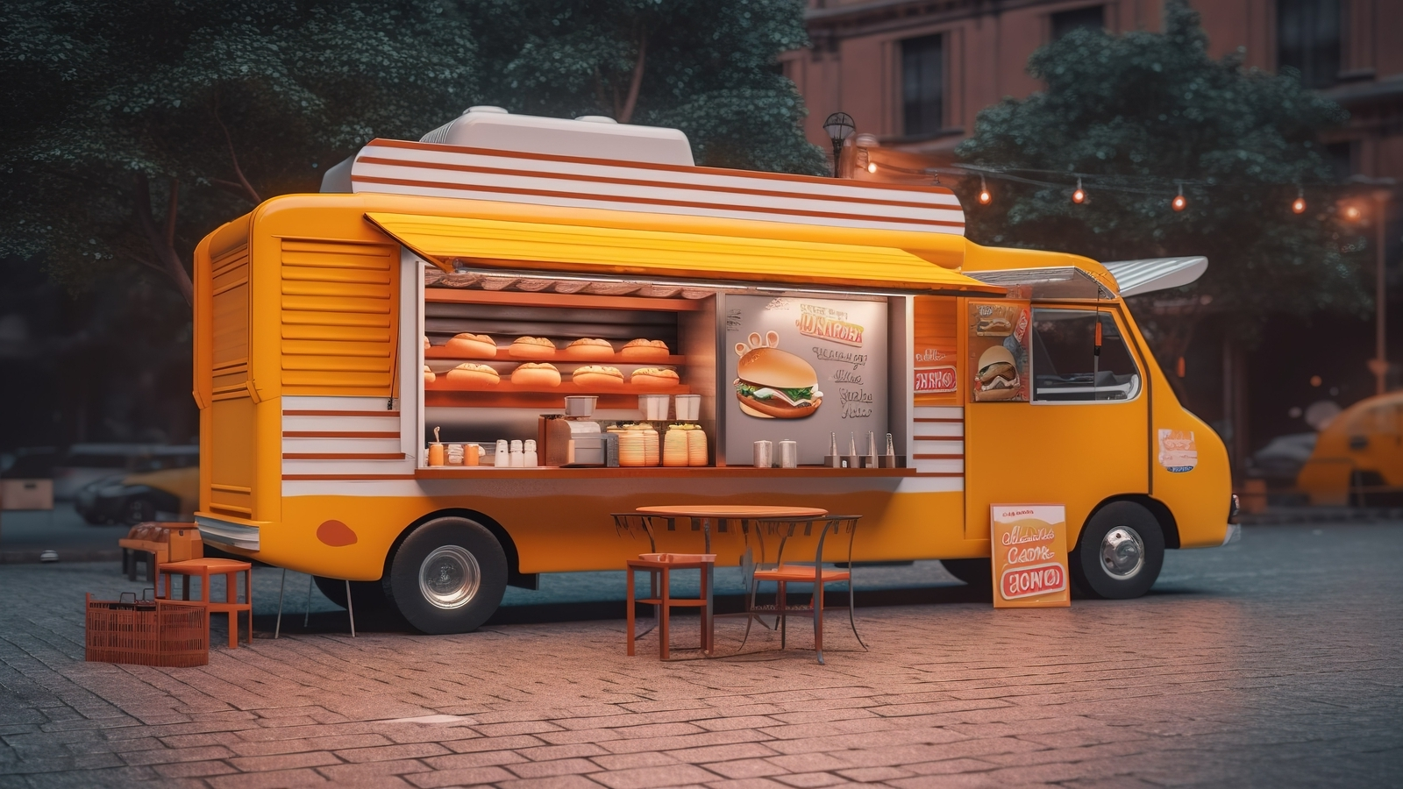
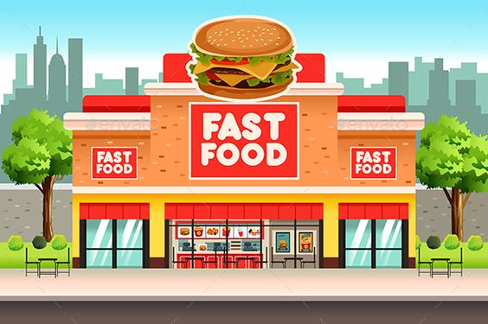
GROUP - 6
Team Member:
Yash Zaveri
Rishabh Shah
Suhas Shetty
Harshitha Chandrashekar
Rahul Pothirendi

Slide 2
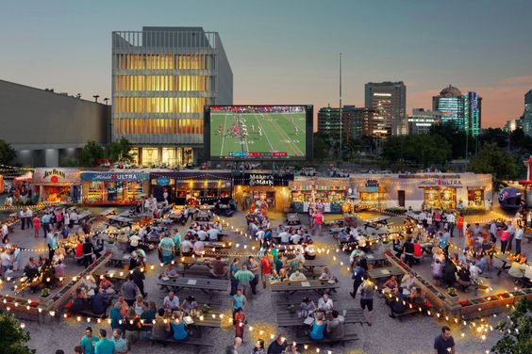
DMDD Group - 6

Slide 4





DMDD Group - 6
OBJECTIVE
1
2
3
Create an Extensive Culinary Database:
Empower Small Food Ventures:
Elevate User Experience:
4
5
Foster Culinary Exploration:
Boost Local Economy:

Slide 5


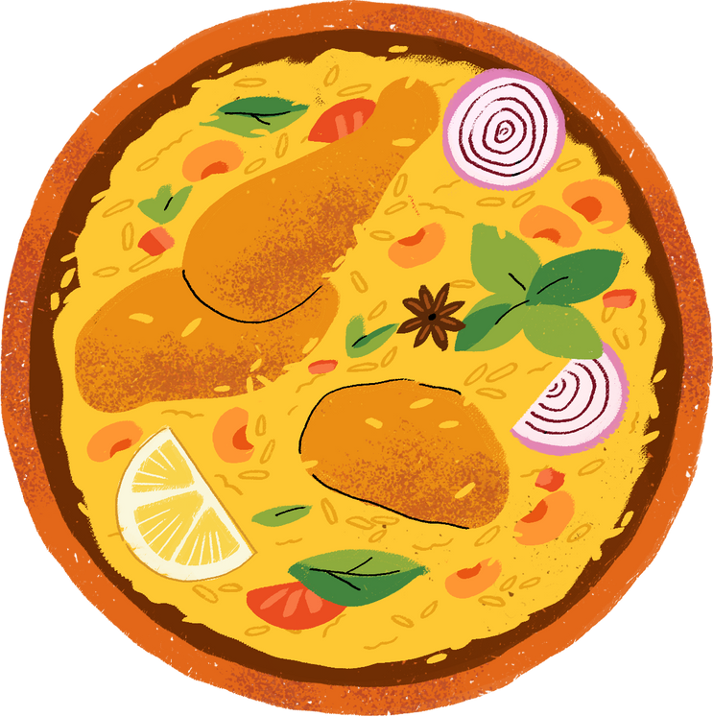
DMDD Group - 6
GOALS
GOAL - 1
GOAL - 2
Comprehensive Cuisine Catalog:
Establishing a centralized repository of diverse culinary options, providing users with easy access to a wide array of cuisines and local eateries.
User-Friendly Interface:
Developing an intuitive and streamlined platform interface for efficient navigation and management of restaurant information, saving users' time and enhancing their dining experiences.
GOAL - 3
GOAL - 4
Personalized Recommendations:
Implementing an advanced recommendation system that analyzes user preferences and dining habits to offer tailored suggestions, thus providing a unified experience for all users seeking culinary exploration.
Seamless Integration:
Integrating various aspects of restaurant management, including menus, reviews, ratings, and health inspection results, into a cohesive system, ensuring a seamless and holistic dining experience for users.

Slide 6

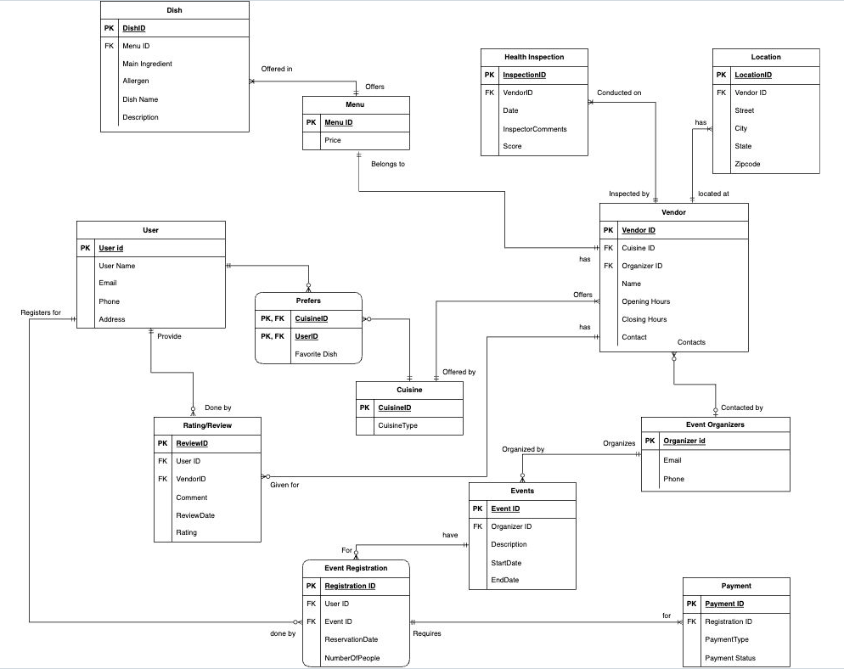


DMDD Group - 6
ERD - ENTITY RELATIONSHIP DIAGRAM

Slide 7
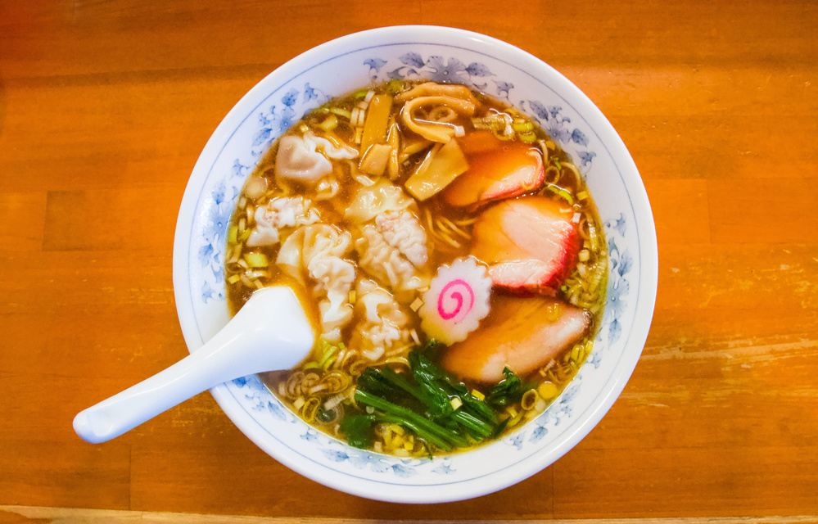
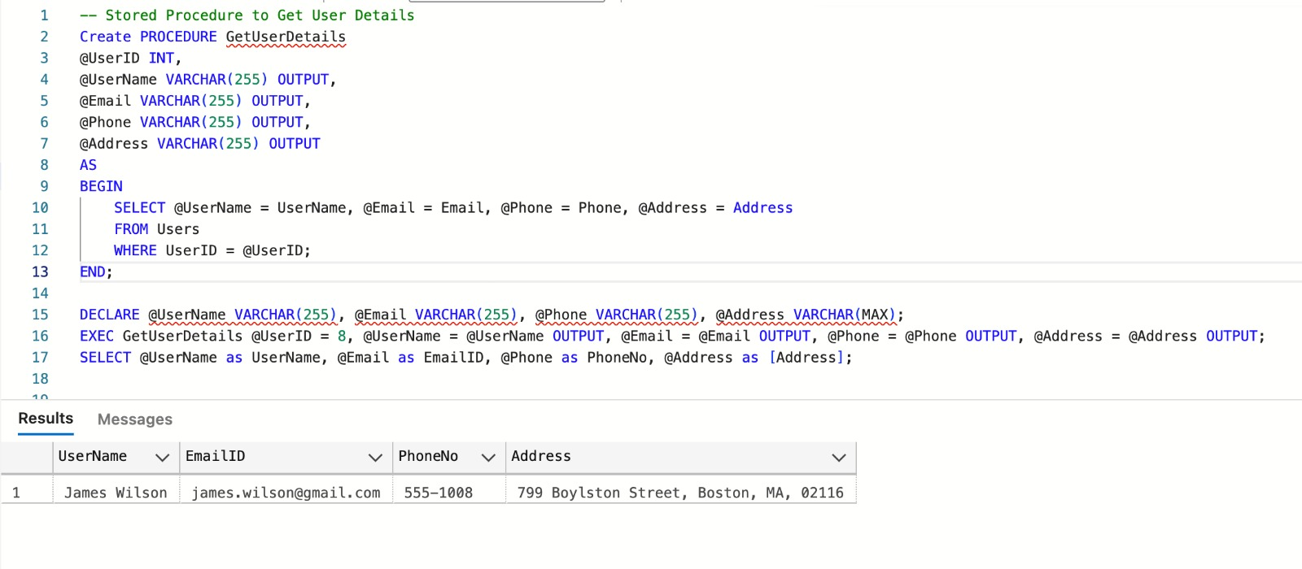
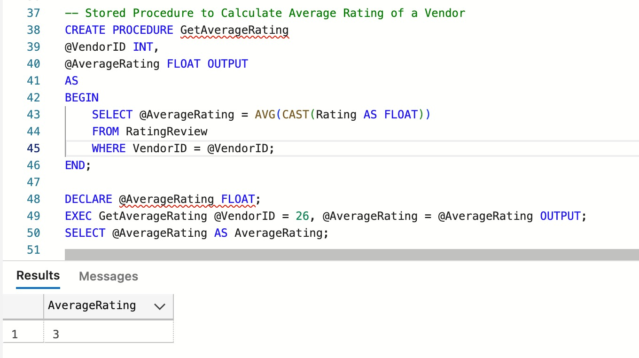
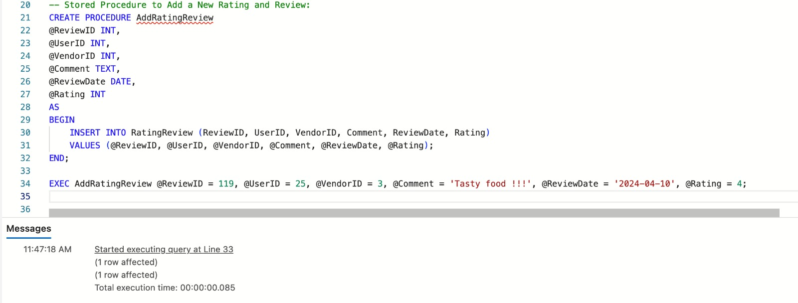
DMDD Group - 6
STORED PRODECURE
GETUSERDETAILS:
GETAVERAGERATING:
ADDRATINGREVIEW:

Slide 8

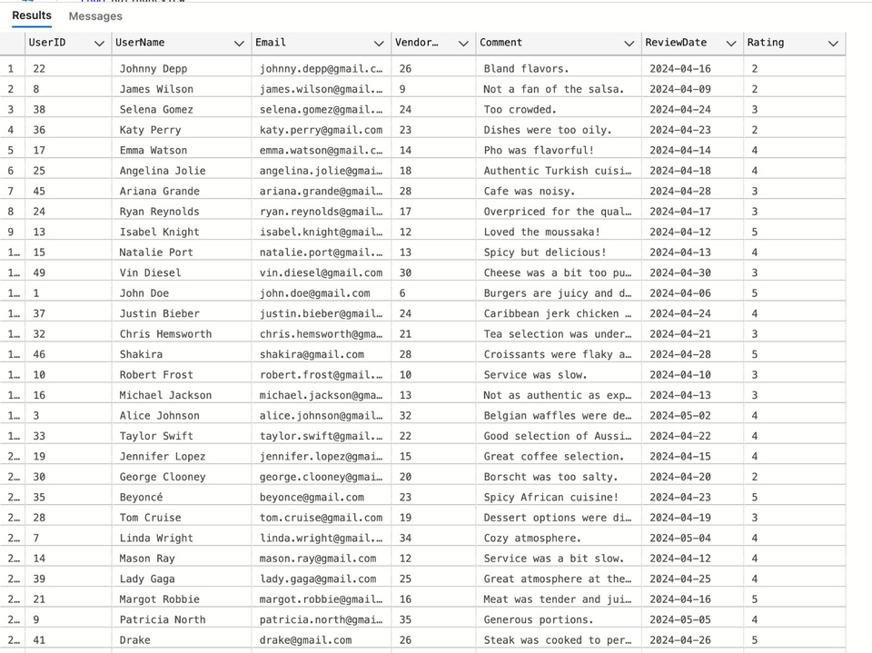
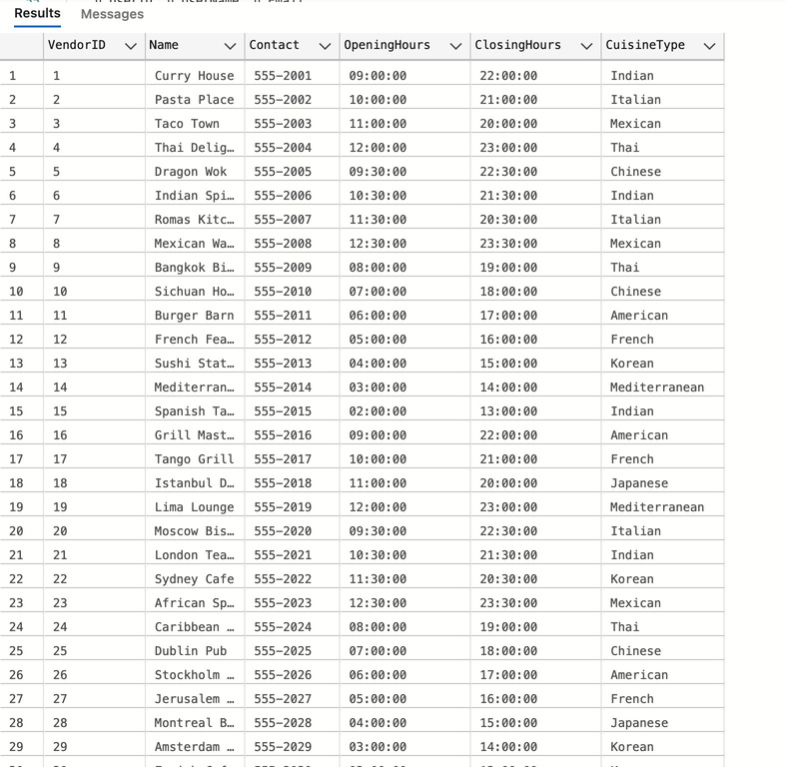
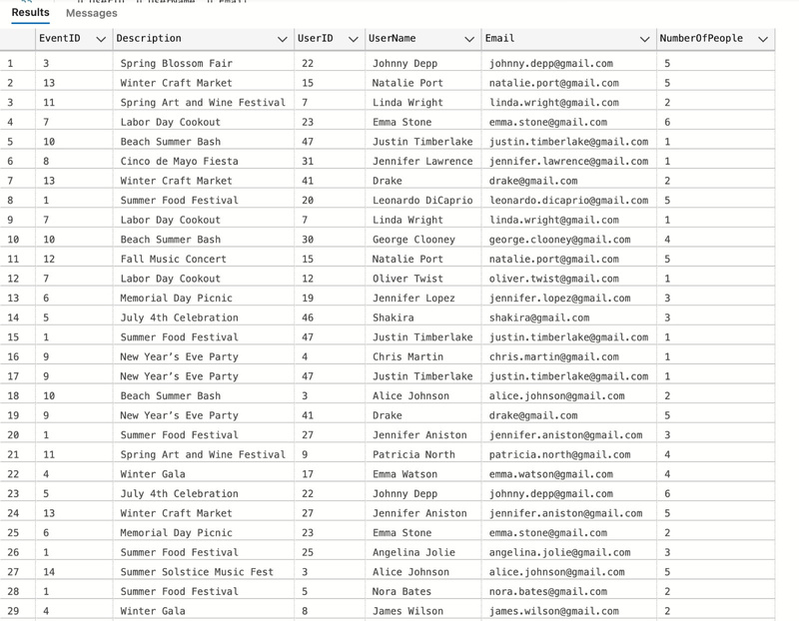
DMDD Group - 6
VIEW
USER
VENDOR
EVENT

Slide 9


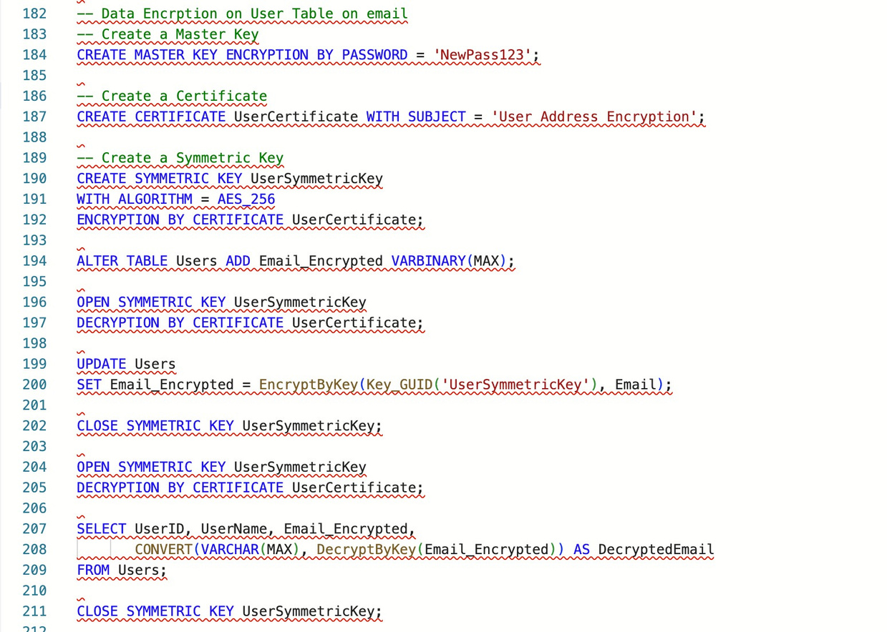
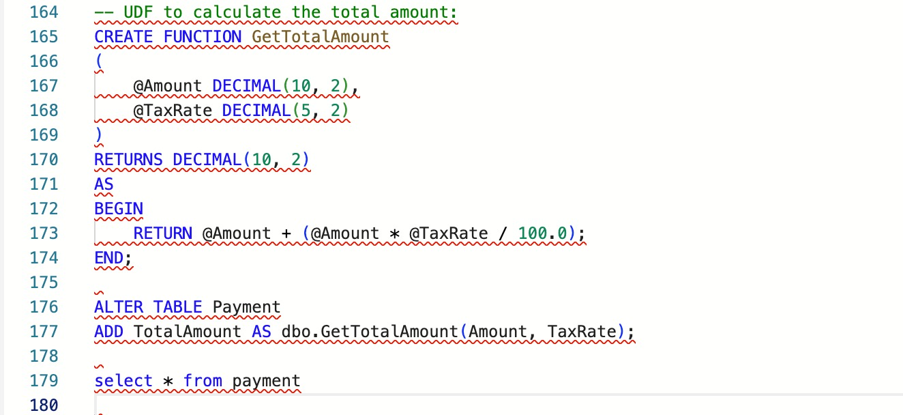
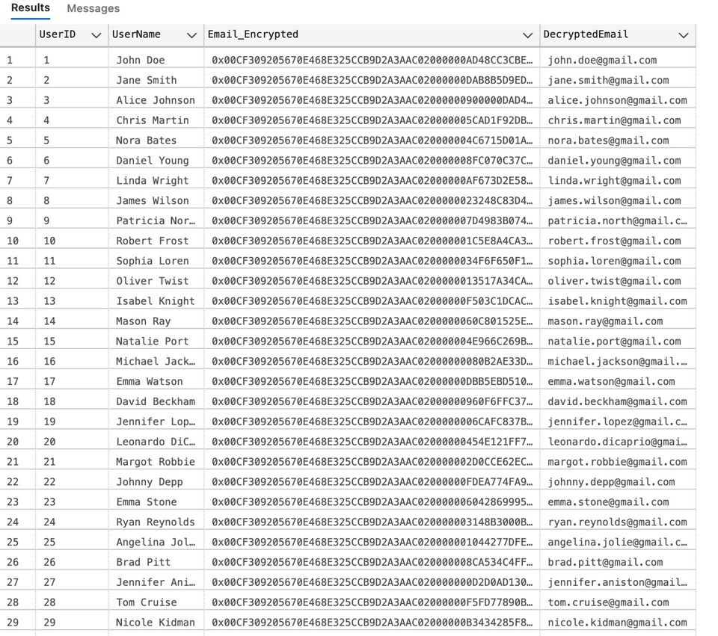
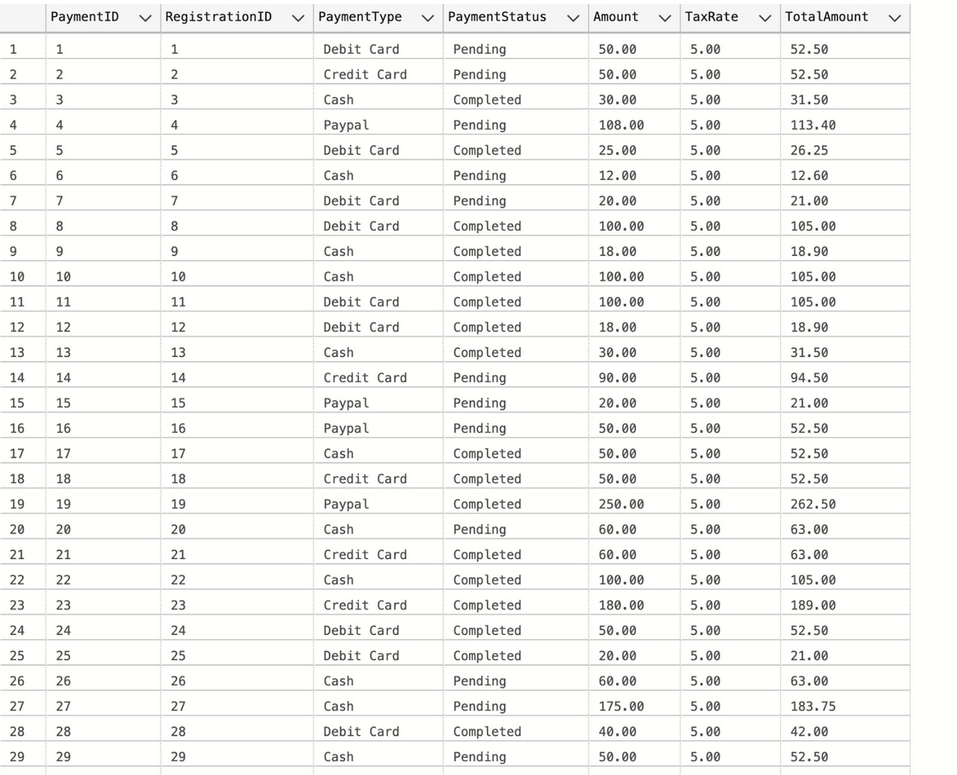
DMDD Group - 6
ENCRYPTION
USER- DEFINED FUNCTION
(UDF)

Slide 10
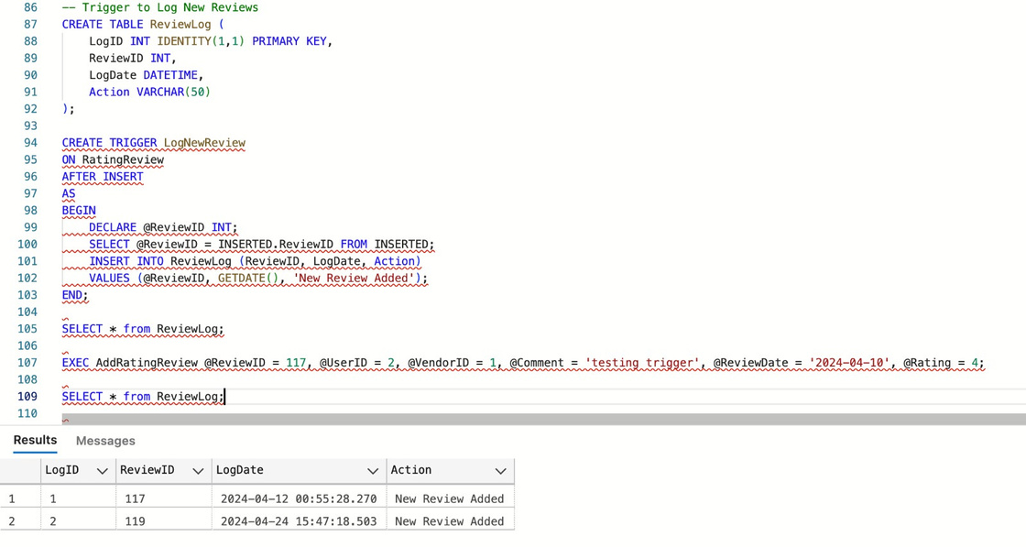
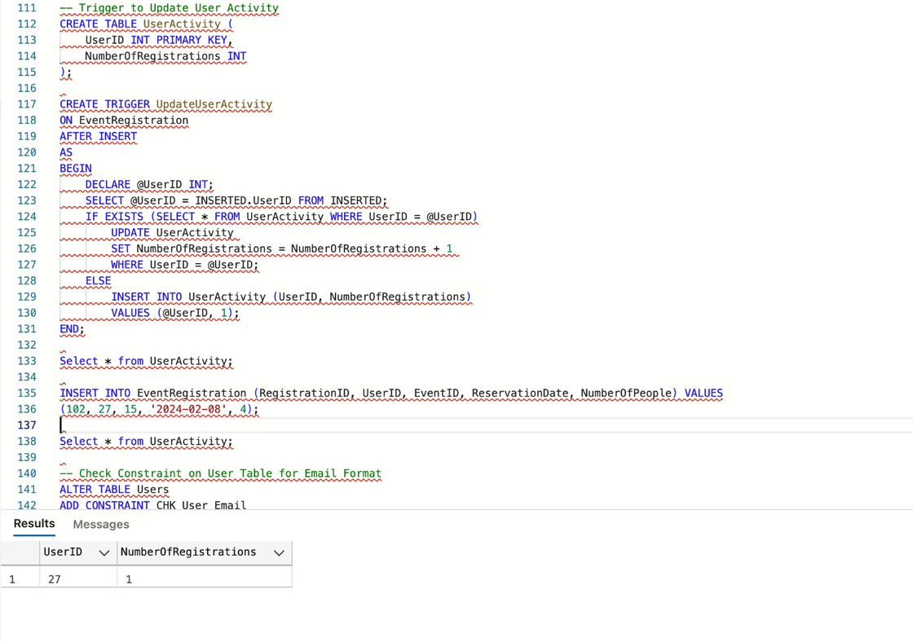
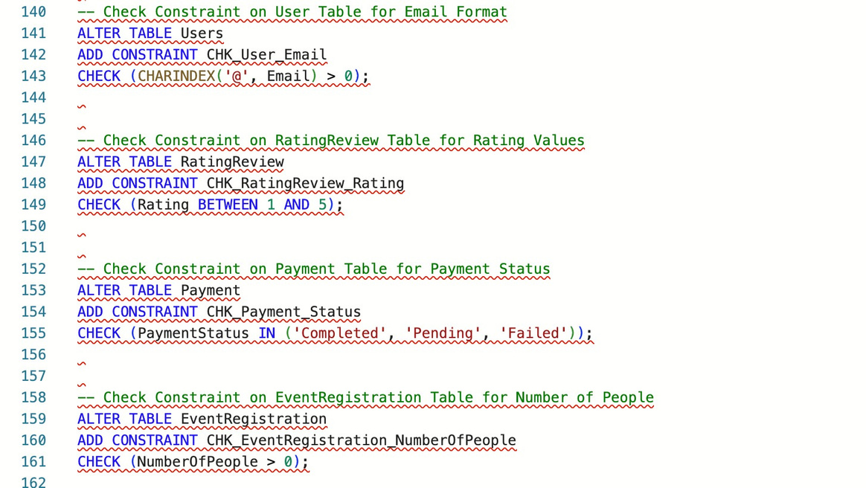

DMDD Group - 6
TRIGGERS
CONSTRAINTS

Slide 11

DMDD Group - 6
GUI

Slide 12


Thank you
END

